Slide 1

BASIC NETWORK SNIFFER
- Name: Meryem FARHAT
- Student ID: CA/JA3/3916
- Domain: Cyber Security
- Duration : 25th January 2025 to 25th April 2025

Slide 2
plan
01
02
03
04
05
Introduction
Project Presentation (Objective & Overview)
Presentation of the Tools (Python & Scapy)
Conclusion
Implementation & Demo (Code Explanation & Execution)

Slide 3
Introduction
🔹 In today's digital world, understanding network traffic is essential for cybersecurity and IT professionals.
🔹 This project focuses on building a basic network sniffer using Python and Scapy to capture and analyze network packets.
🔹 The goal is to understand how data flows in a network and how different protocols interact.

Slide 4
Objective & Overview
Objective:
Capture and analyze network traffic in real time using Python and Scapy.
Overview
What It Does:
Captures IP and ARP packets.
Logs source, destination, protocol, and timestamp.
Applications:
Monitor devices and services.
Troubleshoot network issues.
Detect suspicious activity.

Slide 5
Presentation of the Tools
1️ What is Python?
📌 Python is a high-level, versatile programming language used for:
✔️ Web development 🌐
✔️ Data science 📊
✔️ Cybersecurity 🔒
✔️ Networking automation 🌍
💡 Why Python for networking?
✅ Easy to learn
✅ Large community support
✅ Powerful libraries (like Scapy!)
2️ What is Scapy?
📌 Scapy is a Python library for:
✔️ Capturing & analyzing network packets 📡
✔️ Creating & sending custom packets 🎯
✔️ Performing network security tests 🔍
💡 Why Scapy?
✅ Supports multiple protocols (TCP, UDP, ARP, ICMP, etc.)
✅ More flexible than traditional tools like Wireshark
✅ Used in cybersecurity, ethical hacking, and networking
3️ Python + Scapy = Powerful Network Analysis
📌 With Python & Scapy, you can:
✔️ Build a packet sniffer 🕵️️
✔️ Perform network monitoring 📡
✔️ Create custom network attacks 🚀

Slide 6



Importing Modules
we make it executable
Create a new file
📌 Purpose:
Scapy: Captures and analyzes network packets.
sys & time: Handles arguments and timestamps.

Slide 7
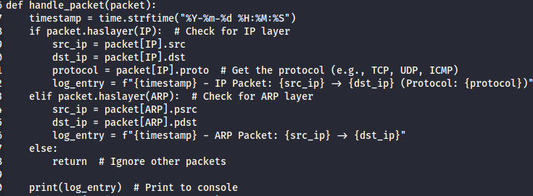
Main Function: handle_packet()
📌 Purpose:
Captures IP & ARP packets.
Extracts important details (source/destination IP, protocol).

Slide 8
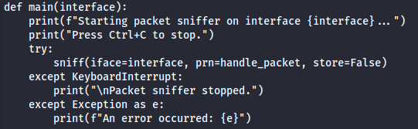
Starting the Sniffer
📌 Purpose:
Continuously captures packets on a given interface.
Can be stopped with Ctrl+C.
Logging Packets
📌 Purpose:
Displays real-time packet information.
Saves logs for later analysis.

Slide 9
Results

Slide 10
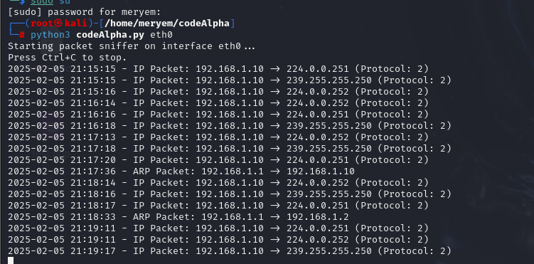
Overview
The packet sniffer captures and logs IP and ARP packets in real-time.
Each line shows:
Timestamp: When the packet was captured.
Source IP: Where the packet is coming from.
Destination IP: Where the packet is going.
Protocol: The type of protocol used (e.g., 2 for IGMP).

Slide 11
Conclusion
🔹 Python and Scapy provide a powerful combination for network analysis and cybersecurity.
🔹 This project demonstrates how we can capture, analyze, and log network traffic efficiently.
🔹 Mastering such tools is crucial for network security, penetration testing, and IT troubleshooting.
🔹 Future improvements could include real-time packet filtering, graphical analysis, and automated alerts.

Slide 12
Thank you

